Slide 1

INTERNATIONAL UNIVERSITY SCHOOL OF COMPUTER SCIENCE AND ENGINEERING
EMBEDDED SYSTEM
FINAL PROJECT: PUMP CONTROL
INSTRUCTOR: VO MINH THANH

Slide 2

Outline
PROJECT OBJECTIVES
SYSTEM DESIGN
HARDWARE COMPONENTS
SOFTWARE REQUIREMENTS
PROJECT PROCEDURE
Algorithm flowchart
Demo

Slide 3
PROJECT OBJECTIVES
Be able to use GPIO, ADC, TIMERS, SPI modules using multitask programming
Have ability to develop multi-task programming using RTX-RTOS

Slide 4
SYSTEM DESIGN
Sensors
Temperature, Soil Moisture, Light
Actuators
Water sprinkler, Heater, Light Source.
Interfaces
LED, GLCD, ADC

Slide 5
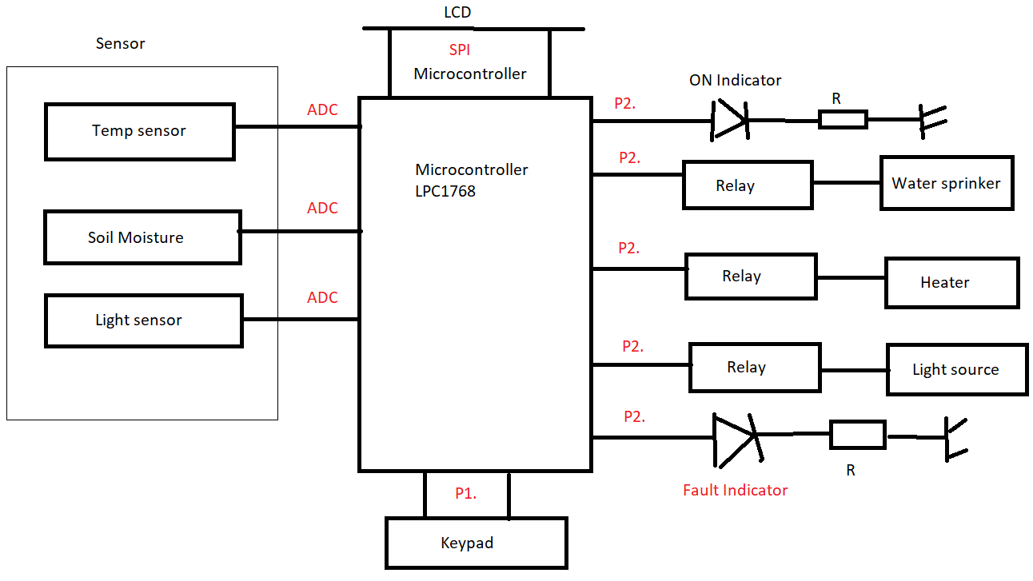

Slide 6

HARDWARE COMPONENTS
LPC1768 microcontroller board
GLCD with SPI interface
Joystick
ADC
LEDs
Jumper wire

Slide 7
SOFTWARE REQUIREMENTS
Keil uVision5 IDE with the LPC1768 board support package
RTX-RTOS library for LPC1768 (can be downloaded from the Keil website)

Slide 8
PROJECT PROCEDURE
Setting up the Hardware
Setting up the RTX-RTOS
GLCD and Joystick Setup
ADC and Moisture Sensor
Timer and Pump Control
UART for Pump Control
Implementing the Menu
RTX-RTOS Integration
Compile and Test

Slide 9
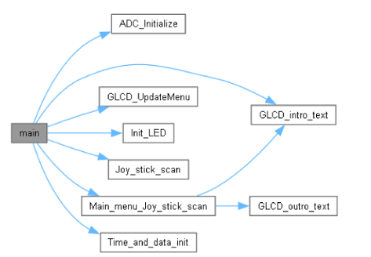
Algorithm flowchart

Slide 10
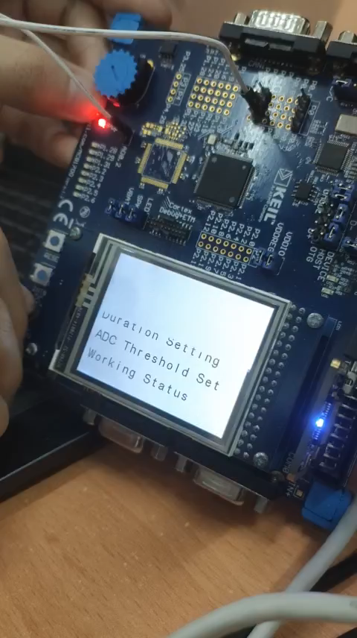

Demo

Slide 11

Q&A

Slide 12

Thanks for your attention

